Slide 1
软件工程
张爽
东北大学软件学院

Slide 2
1.2
Software Crisis &
Software Engineering

Slide 3
Software Crisis
Examples of software failures
  Windows failure
  Office failure
  Website access failure
  ……

Slide 4
Software Crisis
More and more software projects failed.
  on schedule ?
  on budget ?
  fault-free ?
  meet client’s needs ?
1968 NATO Software Engineering Conference
  Software Crisis
  Software Engineering

Slide 5
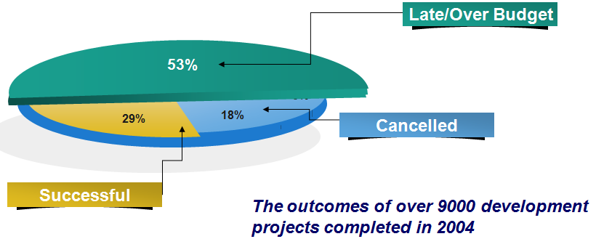
Software Crisis

Slide 6
Software Crisis
  Estimation of cost and progress is usually inaccurate.
  The user is unsatisfied with “completed” software system.
  Software quality is usually unreliable.
  Software is un-maintainable.
  No documentation available.
  Software takes more and more proportion of the total cost of computer system.
  Software development does not match the rapid, deeper and wider computer application.

Slide 7
Software Engineering
The software development is not the mysterious technique of a certain individual labor, but should be the engineering of an organization of all kinds of persons.
Software Engineering studies exactly how to develop and support a software system.

Slide 8
DISCUSS
What is the distinction between computer science and software engineering?

